Slide 1

Connecting the Mobility World with 5G-V2X
Ready to Roll at Global Level
Go-to-market timeline
Vishnu Sundaram
Vice president, telematics BU
HARMAN INTERNATIONAL industries

Slide 2
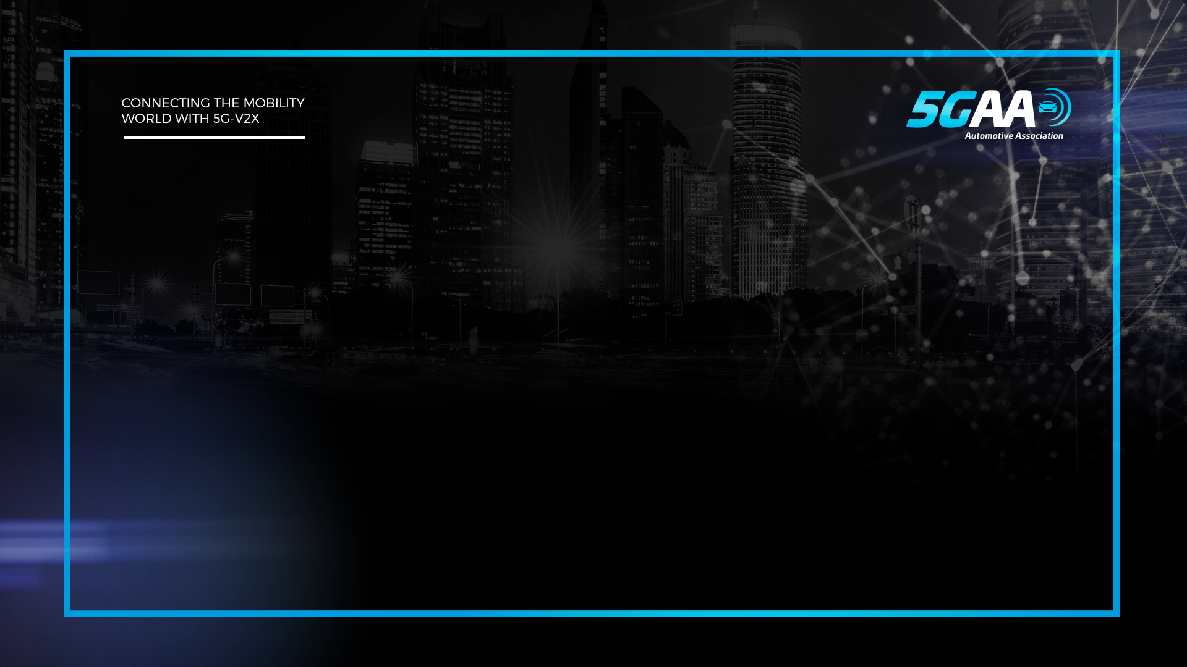




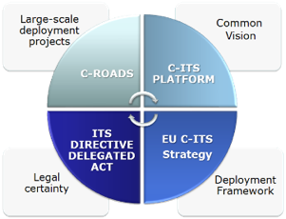









Preparations Round the Globe for C-V2X Rollout
China | C-V2X Support – 20 MHz for Trials in 5.9 GHz First in world – deploy C-V2X on road - 2021 Successful Collaboration: MIIT- IMT -MOT
USA | FCC amendment – introduce C-V2X (5.9 GHz) NHTSA NPRM and USDOT – RFC on V2X communications Encourage OEM requirement for C-V2X
Europe | EC – Connected, Cooperative and Automated Mobility (CCAM) – Vehicles in 2020 with internet Co-operative Intelligent Transport Systems Delegated Act – to include C-V2X – DG MOVE / CONNECT
Korea | Telecommunications Technology Association (TTA) & KOTSA – favour C-V2X - Trials in Seoul

Slide 3
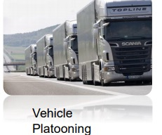
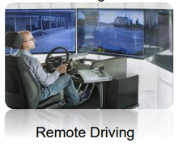
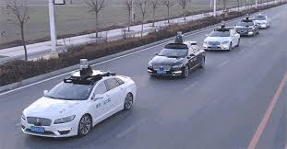

Technology Similarities & Differences - China and Others
Applications
Implementation
V2N/V2I (5G-Uu) is influential than V2V (PC5)
Traffic Management
Driverless remote driving (China mobile, SAIC)
Vehicle platooning
Global standard:
ECC (Elliptical Curve Cryptography) : ECDSA P256/521
China Ciphering algorithms:
128-bit ZUC – designed by DACAS
CCSA input to 3GPP/ETSI (128-EEA3/EIA3)
Regulated by OSCCA
China Cryptography Schemes (C-V2X): SM2, SM3, SM4
Competitor of ECDSA, SHA, AES
China - different ASN.1 structure for security certificate
format (similar to IEEE 1609.2/ETSI TS 103 097)
  China PKI architecture - Similar to US SCMS / EU CCMS
DACAS - Data Assurance and Communication Security Research Center of the Chinese Academy of Sciences
CCSA - China Communications Standards Association
Office of the State Commercial Cryptography Administration (OSCCA)

Slide 4

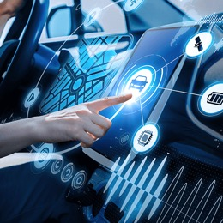
Bold move to pre-enable C-V2X on all TCU line.
Dedicated product teams for China & RoW
Committed launch of 5G & C-V2X Ready for 2021
Tests & Trials
Demonstrated vehicle “talking” to motorcycle using C-V2X communications, CES 2019
Leading 1st 5GAA C-V2X multi-vendor plugfest – Technology maturity via IOT….
Working with SAMSUNG & KOTSA Build 5G–V2X Test Zone for Connected Cars and Autonomous Vehicles (K-city 360,000m²)….

Slide 5


Thank you

